Slide 1
Gent, 30.4. – 2.5.2015
Workshop 2
„New developments in physical activity programs for elderly people,…“

Slide 2
Gent, 30.4. – 2.5.2015
OSTEOPOROSIS
MUDr. Vlasta Syslová

Slide 3
Gent, 30.4. – 2.5.2015
MUDr. Vlasta Syslová
Chairman of commission of remedial physical education, ČASPV
Member of Society of Sports Medicine the Czech Republic

Slide 4
Gent, 30.4. – 2.5.2015
Prevention and physical activity during osteoporosis
Target group
Women after menopause
Remarks – not everybody has level of osteoporosis evaluated or measured by densitometry
Aims of exercise programme
To keep bone mass
To improve bone mass
To stop lowering of bone mass

Slide 5
Gent, 30.4. – 2.5.2015
WHY?
ČASPV is sport organisation oriented practicly on exercises
Scientific research is not our goal
We invite medical expert to our educational seminars
Practical part oriented to special topic
Psychiatric problems
Lymphoedema
Hip and knee replacement
Heart problems…
Methodological annex with tray exercises and recommendation in our magazine (Pohyb je život) for our instructors and medical sector

Slide 6
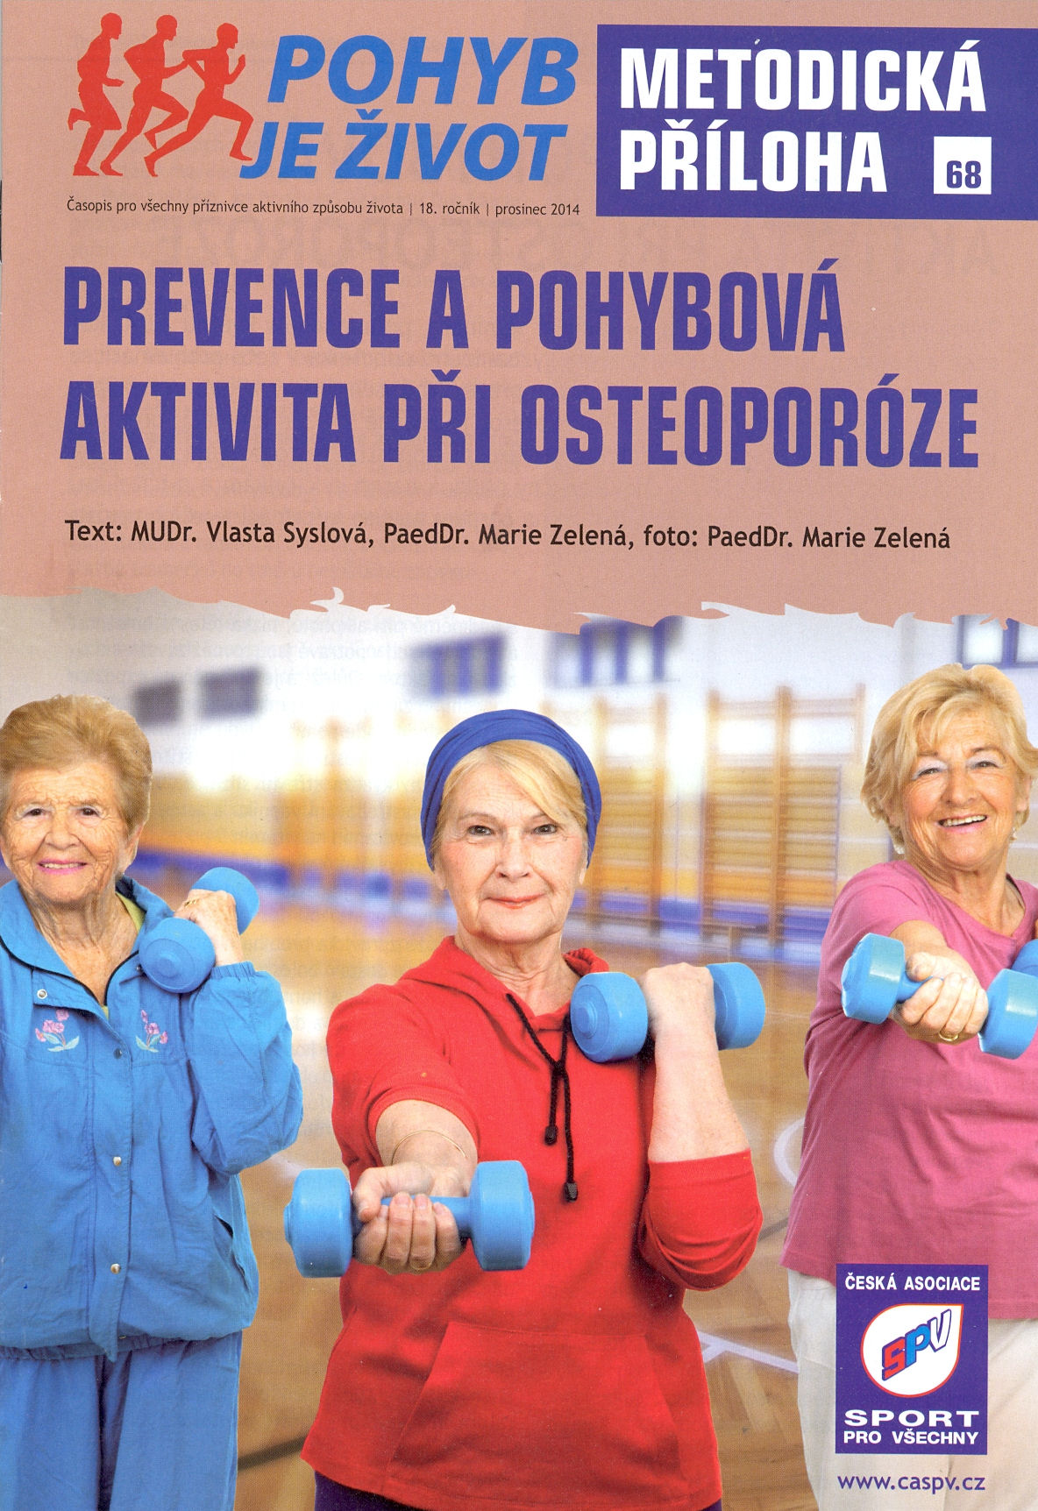

Slide 7
Gent, 30.4. – 2.5.2015
Why is this topic important for „us“
Low afinity mostly of elderly people to the movement
Function of exercise programme
Prevention
Treatment
Little awareness of physicians about influence of exercise during osteoporosis
Economic impact

Slide 8
Gent, 30.4. – 2.5.2015
Osteoporosis – definition
Progressive disease of skeleton
Disorder of microarchitecture of bone tissue
Follow – up by increasing of bone fragility

Slide 9
Gent, 30.4. – 2.5.2015
Development of osteoporosis
No problem for a long time
Back pains (compression and deformation of vertebrae)
Kyphosis Th – hyperlordosis L
Loss of bone strength
Loss of muscle mass
- Muscle imbalances
- Falls fractures (femoral neck, vertabrae, wrist…)

Slide 10
Gent, 30.4. – 2.5.2015
What can we affect/cannot affect
What cannot we affect:
Genetics
Gender
Race…
What can we affect:
Nutrition
Sedentary lifestyle
Adequate exposition to soneshine
Suitable movement

Slide 11
Gent, 30.4. – 2.5.2015
IMPACTS of suitable exercises
BONES
Mechanical irritation/stimulation affects bone cells
Bone cells are responsible for creation of the bone mass
Bone beams are reseted in the direction of the load
BODY
Release of paintful contractures around osteoporotic bones
Minimalisation of muscle imbalances
Maintain adequate muscle mass decreasing risk of falls
Well trained deep stabilisation system cushions compressed vertebrae and decreases pains
Stop age related bone loss

Slide 12
Gent, 30.4. – 2.5.2015
Suitable kind of exercices
Strength – resistence training (machines, own body…)
Lower weights
More repetition
Combitation with endurance training
Standing exercises (antigravity muscles work)
Walking up stairs (strengthening of legs)
Other suitable physical activity: „Nordic walking“ …

Slide 13
Gent, 30.4. – 2.5.2015
REMARKS
Combination with Calcium and Vitamin D3 (Vigantol)
Vigantol – positively influences muscle mass of m. quadriceps
Exercise 1hour, twice a week, 8months – can increase bone density of vertebrae by 3,5%
NEWS:
The whole body vibration irritates nerve receptores – stimulation of osteogenesis (new building of bones)
Recommended: 10 minutes, twice daily, 12 months, intensity 30 Hz – in combination with vitamin D3 and Calcium

Slide 14
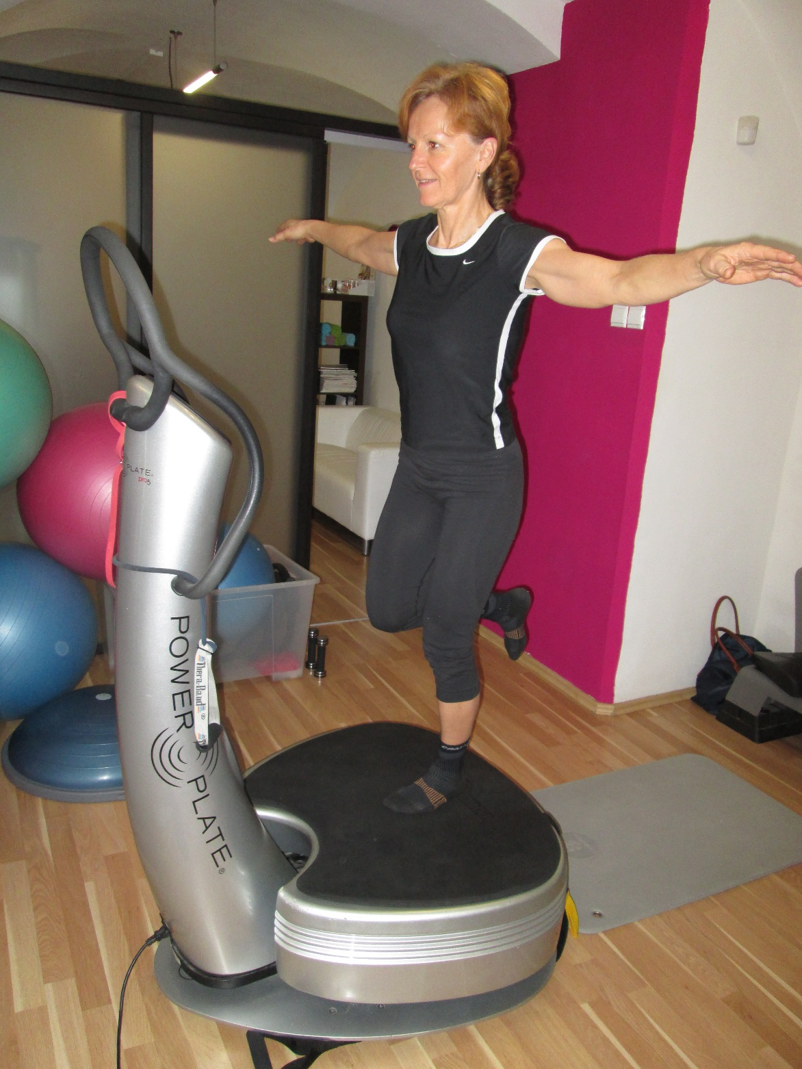
POWER PLATE

Slide 16
Gent, 30.4. – 2.5.2015
Future projects of
Project:
„Multi-dimensional Assessment and Intervention Model for exercixe and physical activity in adults and elderly with cognitive impairment“. (ERASMUS +)
Co-operation with Senivia - project Senior holding s.r.o.
Je určený především občanům České republiky starších 55 let, ale i jejich rodinným příslušníkům. Hlavním posláním je vytvoření uživatelsky přívětivého a nápomocného místa na internetu určeného pro tuto cílovou skupinu.

Slide 17
Gent, 30.4. – 2.5.2015
Thank you for your attention

