Slide 1
Adults and seniorprogram Flemish Athletic Federation
Friday 01.05.2015

Slide 2
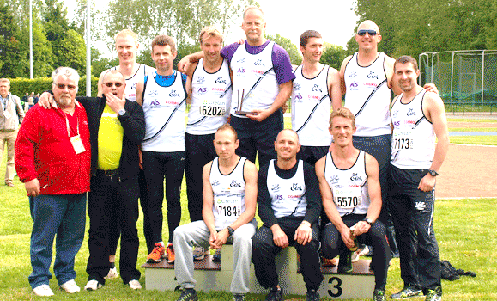
87 clubs
Competition and recreation
5 y – 99 y

Slide 3
“Masters” in competition
16 %

Slide 4
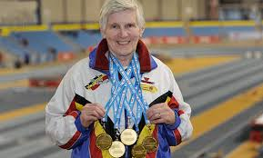
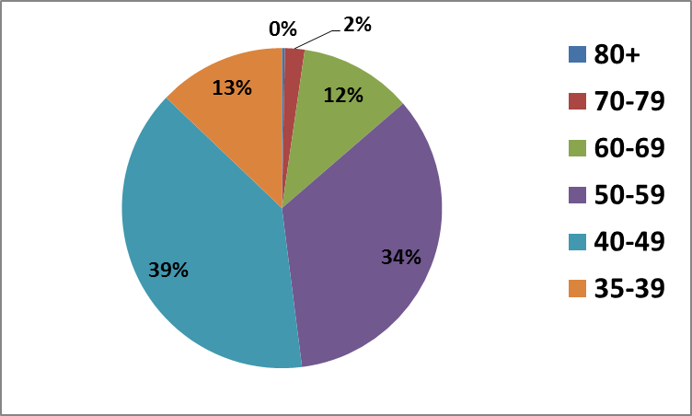
Active masters competition and recreation (4026) (5838)
°1935 or earlier 80+ 30
1945-1936 70-79 195
1955-1946 60-69 1123
1965-1956 50-59 3387
1975-1966 40-49 3860
1985-1976 35-39 1270

Slide 5
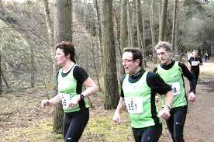
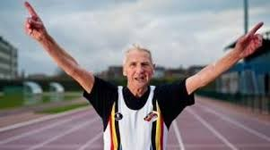
Competition vs. recreation
4026 | competition | 41%
5838 | recreation | 59%

Slide 6
Recreative program
Start in 2001
10 week – jogprogram
From 0 till 5km running
Peak moment in 2006-2007 : 15.000 participants/year
Too small number of affiliation in the club
Time for changement!

Slide 7
Goal for the new program
Recreative full year program
More members in the federation Athletics as familysport
Create en accessible program for adults
Cheap
No or little sports experience
Variation
Modular organisation form (about 10 weeks/module)

Slide 8
FitFree
Recreative program for
Adults
Seniors (55+)
No sports experience
Possible in combination with Start to Run program

Slide 9
FitFree
General movement skills: stabilisation, agility, balance, coördination, endurance
2 sessions / week from 1 hour
4 modules from ± 10 weeks
Each module different in organization
Circuit (indoor)
Partner exercises (indoor)
Fartlek (outdoor) → walk or jog → combination Start to Run
Athletic games (outdoor)
Most of all:
No obligation, PLESURE in movement is the most important!

Slide 10
Most difficult: to convince the clubs
Clubs =
Focus on competition
Focus on youth
No interest in recreation for adults
No coaches for (adult) recreation

Slide 11
Sensibilisation
Development of a recreation fund for the clubs
Recreation program for adults = points = money for the club
Quality in coaching = extra points
Special accommodation = extra points
…
Information sessions for clubs to share “good practices”
Club visits to raise the awareness for recreation

Slide 12
Support
The federation
looks for “entertrainers” (universities and high schools for physical education)
pays the entertrainers (during the pilotprogram)
has an educational program for the entertrainers (modular)
offers the promotional materials (flyers, posters)
provides the exercises per module

Slide 13
Succes?
Yes, succes is possible !
BUD
Intensive promotion (mailing, website, facebook, …)
Work together with other social partners and doctors, fysiotherapists, … who promote the program
Intensive follow-up of the participants
An enthusiastic organisator in de club is essential !

Slide 14
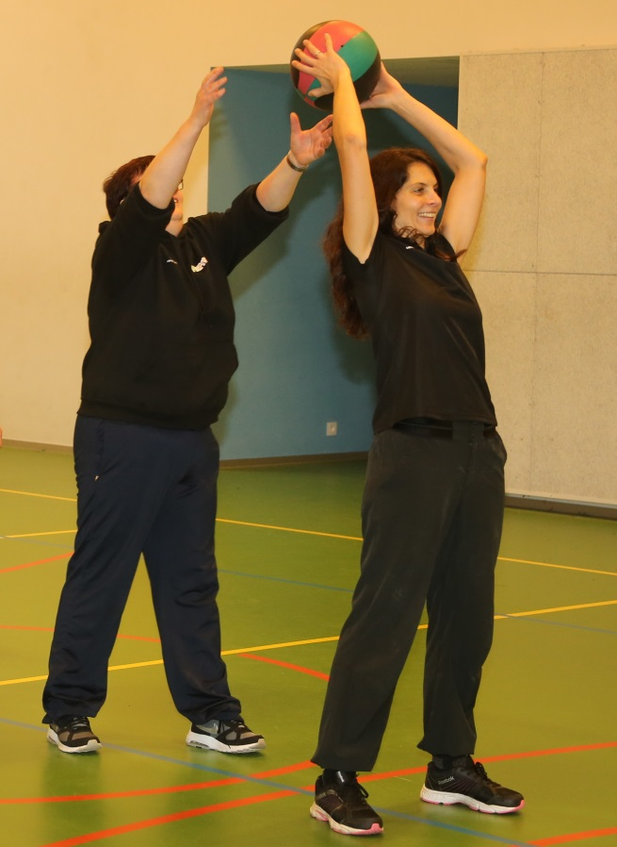
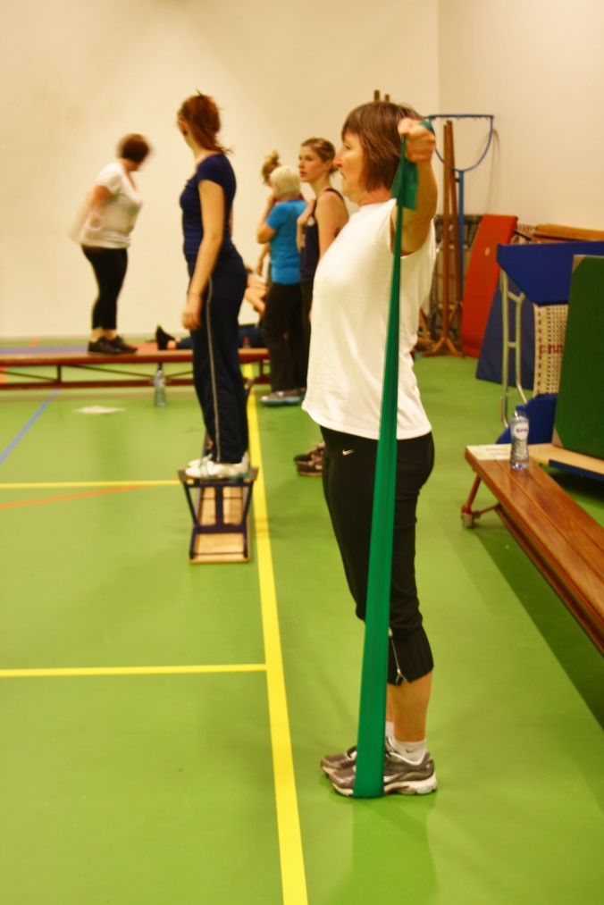
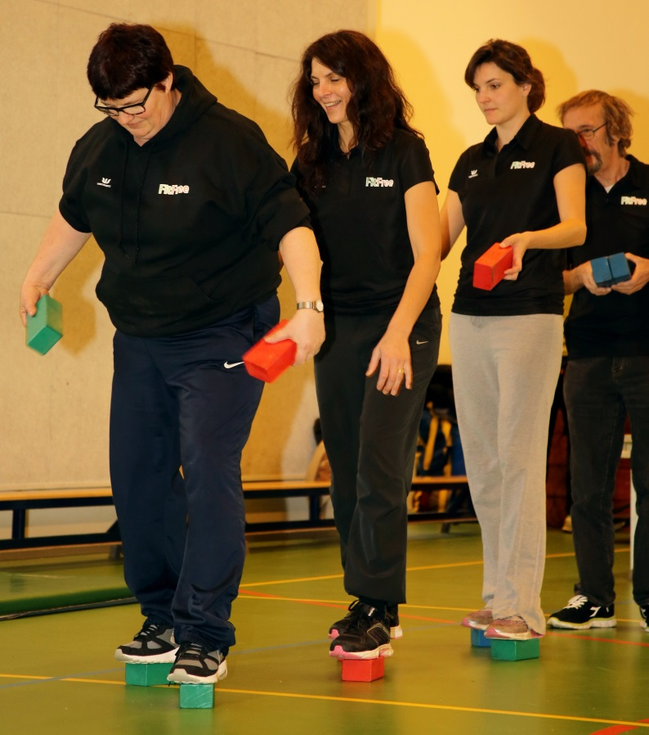
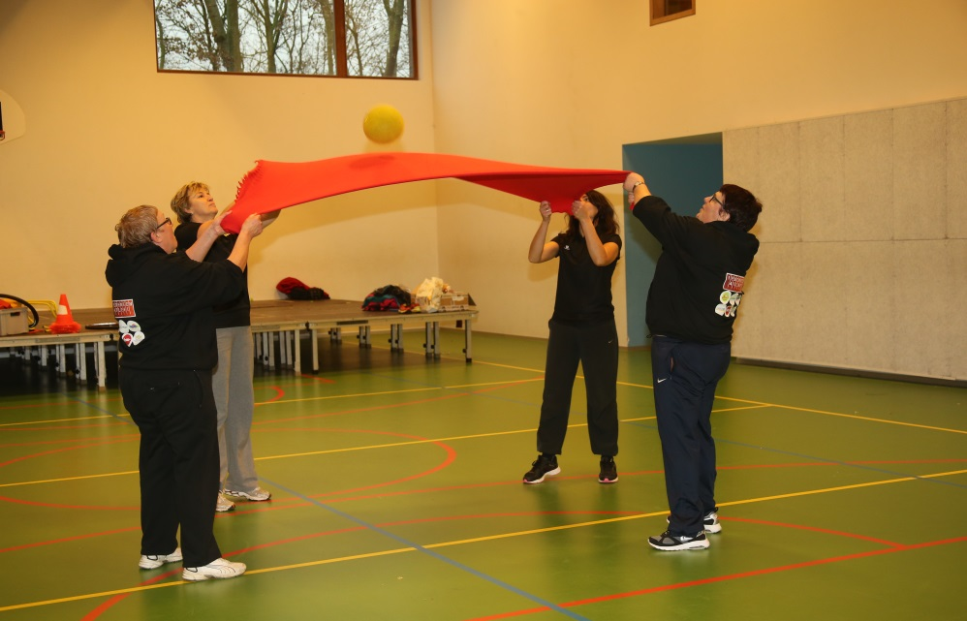
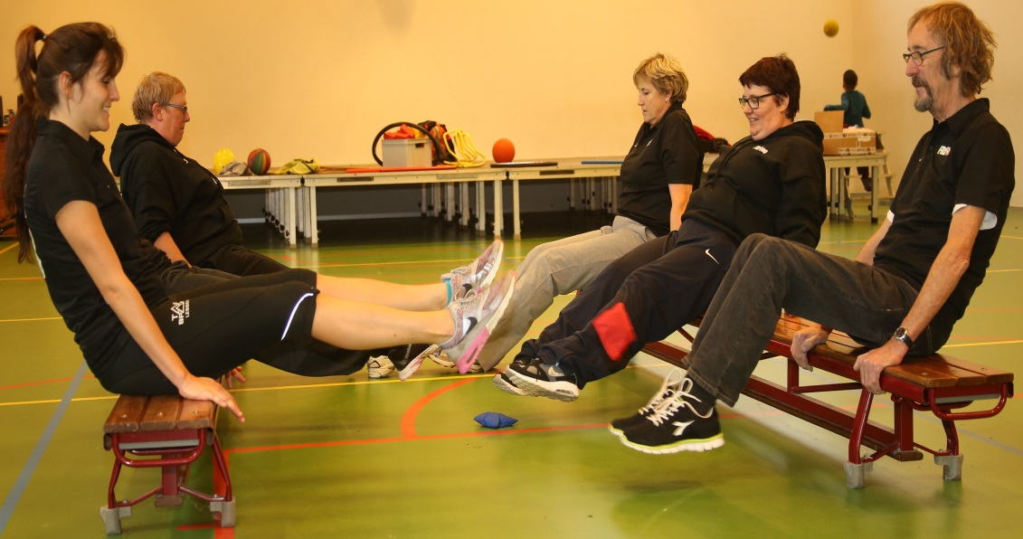

Slide 15
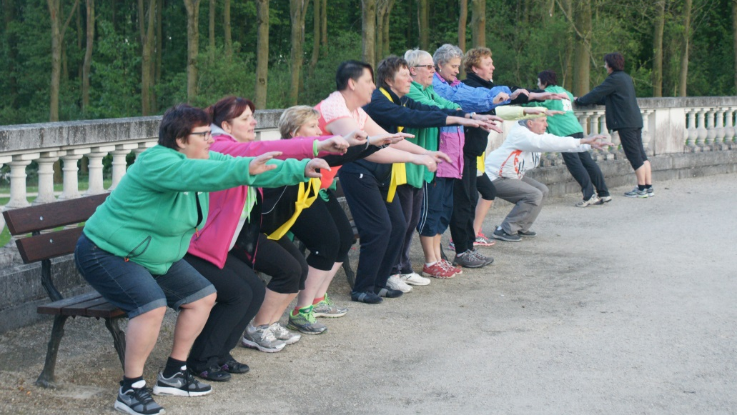
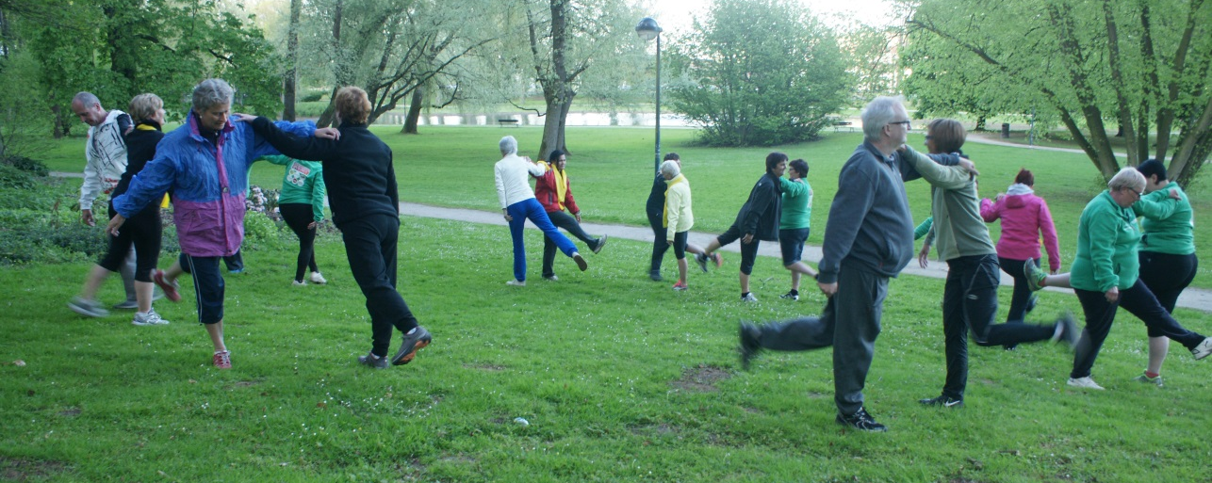
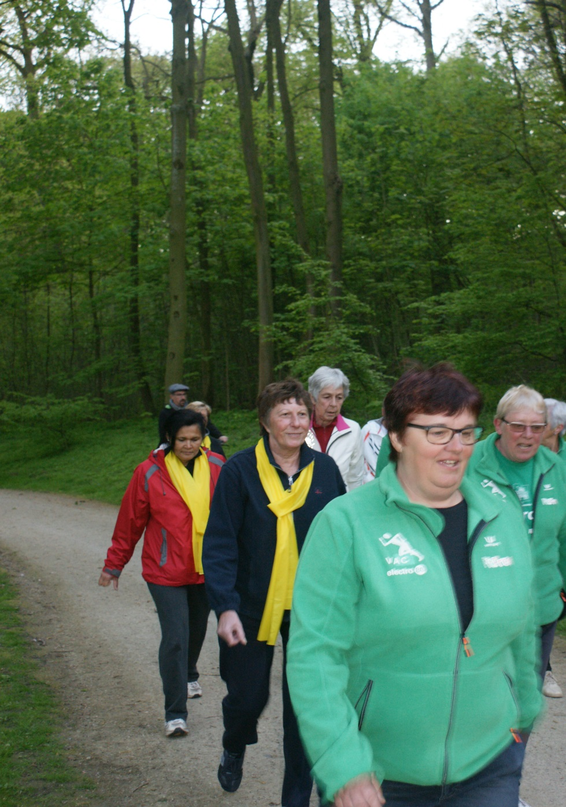
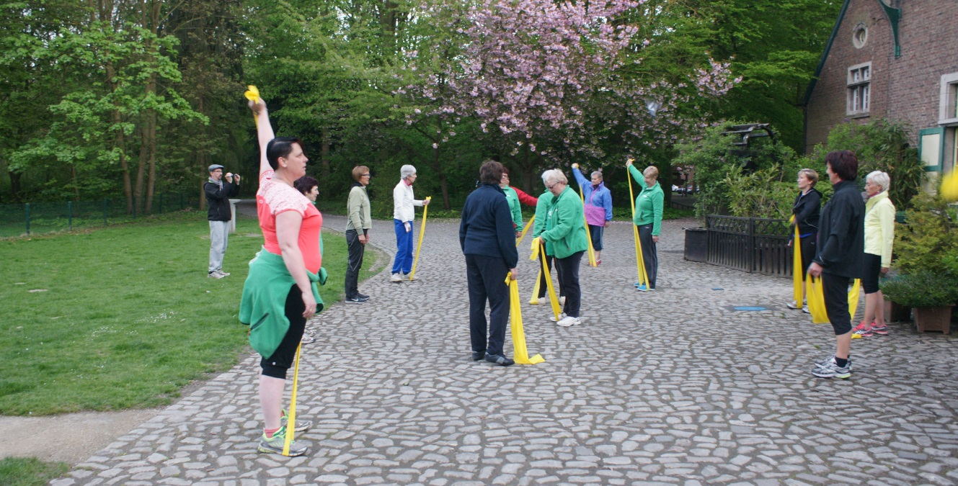
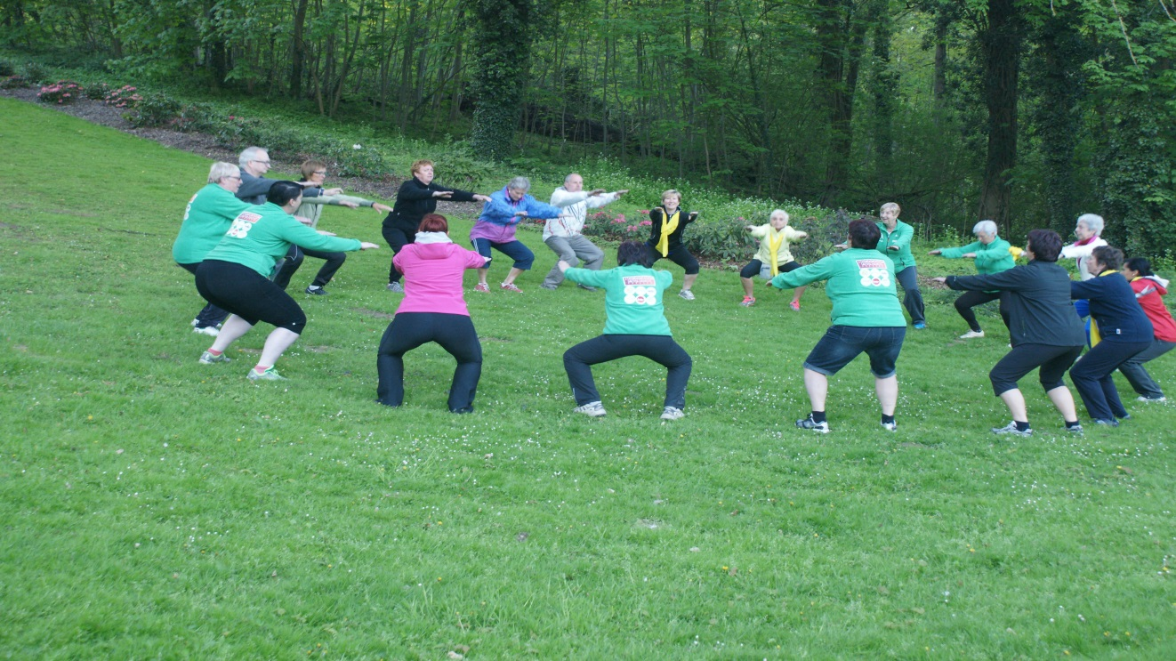

Slide 16
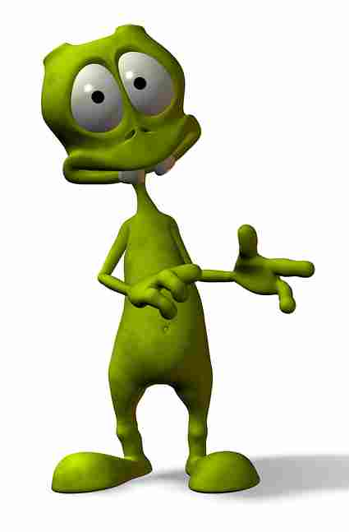
To remember…
Your goal is achieved if the participants have a good feeling after the session.
Everyone can participate at his own rhythm, according to his own needs, when it fits.

Slide 17
Questions ?

