Slide 1
Moving Age – Meeting – May, 2015
Current issues about the topic “elderly” in the German Gymnastics Federation
Speaker:
Detlef Mann - member of the DTB Board GfA resp. for specific groups / elderly

Slide 2
Active and fit living
a project of the
German Gymnastics Federation
01/2013 – 07/2015

Slide 3
Objectives of the project
To implement sustainable physical activity programs in communities for inactive people of three target groups:
old-old people (over 80 years of age)
people suffering from dementia
informal caregivers (less succesfull)
and to motivate and enable them to participate in this physical activity programs.

Slide 4
Relevant actors and their competences
knowledge how to move people
Educated/qualified instructors
specific view
connection to other relevant institutions
global view
finance and personal ressources
Sports Clubs
commune
many other partners
direct contact with the target group
materials, like mini vans

Slide 5
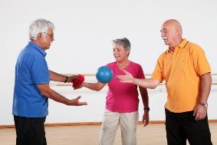
Realisation of the project
Six pilot communities
Negotiations sports clubs and commune
Nomination of a locally responsible
Approach and link other institutions to the network
Create basic conditions
Promote the physical activity program
Realize the physical activity program
Membership in the sports club after half a year

Slide 6
Challenges and difficulties
challenges
Acquisition of new partners
transmission to membership e.g. member fee, type of membership
difficulties
Vehicle/car operation
motivate and enable people with dementia and care givers
insurance for active people in the program

Slide 7
Outcomes of the project
a handbook/manual for communities
with the relevant steps for a sustainable implementation of physical activity programs for the respective target groups
Notes:
Im Bereich pflegende Angehörige so wenig Informationen, dass diese Gruppe im Service Ordner keine oder sehr wenig Beachtung finden wird

Slide 8
Factors of success
feasible basic conditions
public relations
motivated actors
personal contact
simple membership
trial lesson
network
public relations
Notes:
Diese Folie hatte ich damals nicht gezeigt, oder zumindest nicht intensiv besprochen
What is important? What needs to get the elderly motivated and to enable them be more active
Pressearbeit
Richtige Rahmenbedingungen (Zeitfenster, barrierefreier Raum, Wohnort naher Raum)
Motivierter Acteure (Übungsleiter, Netzwerkkoordinator hauptamtlich)
Persönlichen Kontakt suchen
Schnuppern lassen
Schnellkündbare Mitgliedschaft (grüne Bananen)
Motivation durch Sport ferne Personen, z.B. sozialer Pflegedienst

Slide 9
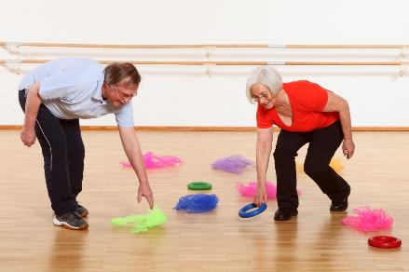
Thank you for your attention
Any questions
?
Notes:
Wird noch schöner gemacht

Slide 10
Convention „Active living – activ and fit in the 2nd phase of life“

Slide 11
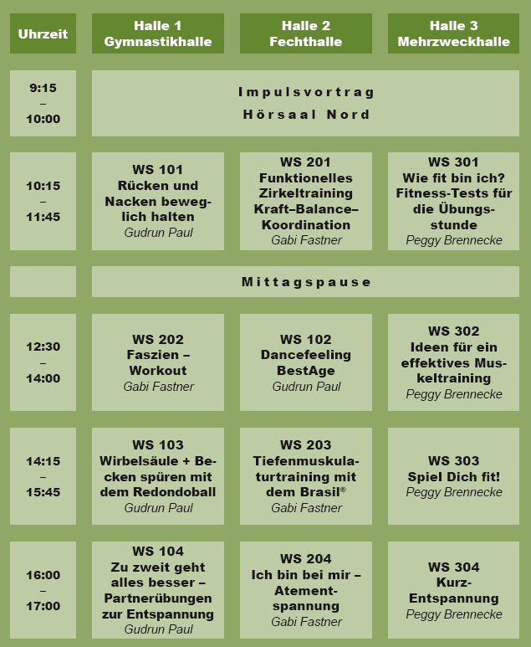
Convention
AIM: trainer get new ideas for their practical work
Notes:
After a speech to the topic „How to get (1) fit, non-organised and (2) inactive elderly over 60 years of age in our assocciation“ the participants have the possibility to chose between 3 workshops. 4 Times

Slide 12
Flyer
Notes:
Beispiel Flyer, falls noch Fragen kommen,…oder als Beispiel einbauen, mal sehen

Slide 13
Notes:
Einlegeblatt als Beispiel

