Slide 1
eLF Project
e-Learning Fitness Project
Project No. 511669-LLP-1-2010-1-IT-KA3-KA3MP-ELF
1/1/2011 – 31/12/2013 (36 months)
Education, Audiovisual and Culture Executive Agency (EACEA)
Programme: Lifelong Learning Programme
Sub-programme: KA3 ICT
Call for proposals: DG EAC/41/09
Action: Multilateral project

Slide 2
Purpose and Deliverables
This project proposes the creation of a system of training and qualification, based on EQF - the European Qualification Framework - in the fitness industry, culminating with a permanent institution of a National Register of Certified Professionals in 14 European countries.
A long term target is to improve health ‑ hence the quality of life ‑ to all the people involved in fitness activities: almost everybody, as long as this is done by qualified instructors, paying attention to individual needs. The main objectives of the project/network are:
1. to create a European training system for e-learning in fitness to cover the minimum standards for both the theory (knowledge) and the practical skills and competencies
2. to create a platform for an interactive national professional register which will collaborate with other international registers. The e-learning courses and register will be translated into the languages of the project members.

Slide 3
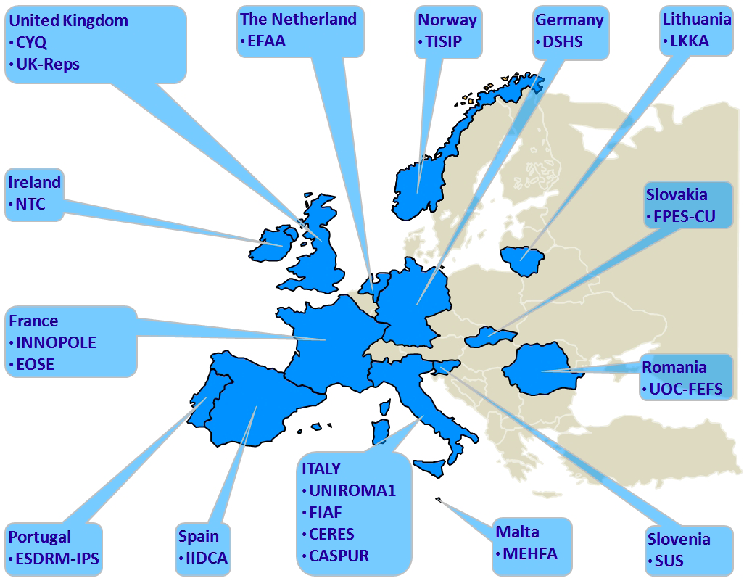
Membership
19 Full Partners

Slide 4
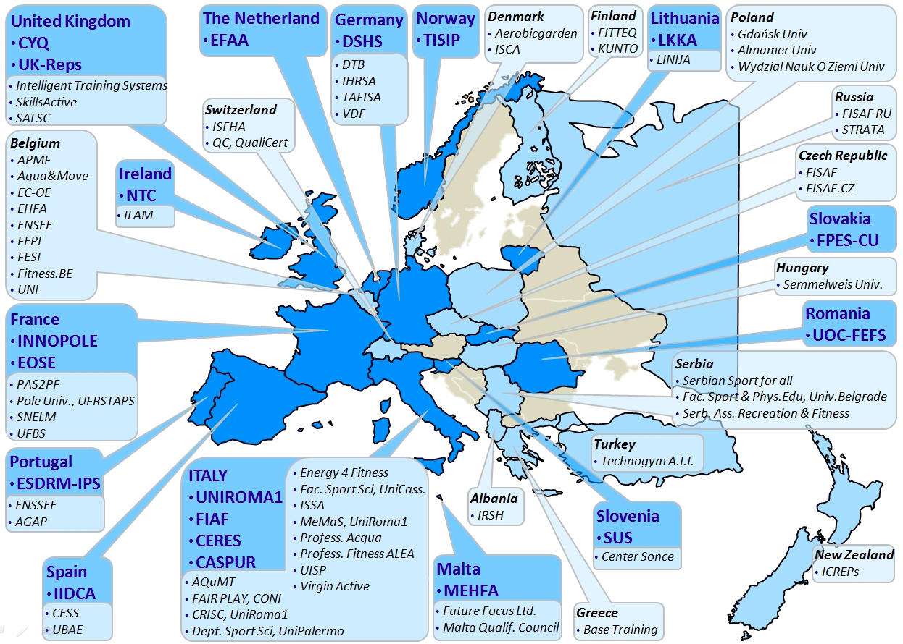
Membership
Associate Partners

Slide 5
Purpose of membership for Associate Partners
No funding
Participation in Pilot Testing
Participation in the Testing of the Exercise Register
Dissemination
Exploitation

Slide 6
REGISTER OF EXERCISE PROFESSIONALS
DELIVERABLE: to create a platform for an interactive national professional register which will collaborate with other international registers.
The national register is being developed based on the UK-Reps, http://www.exerciseregister.org and will be localized and translated into each of the national languages of the participating nations.
All participants who successfully complete the e-learning programmes will be eligible to join the national register of their country.
These registers will communicate among themselves and with other registers outside of Europe through ICREPS (associate partner).
eLF full partner, CYQ, will perform a quality check on all the eLF Programmes to ensure that they meet the EHFA standards and be able to endorse the programmes.
eLF qualified instructors should/will be able to qualify to register on EREPS, if they choose to do so.
It will be up to the individual partners/nations to ensure that the register is recognized/accredited by the appropriate national authorities and is managed in a transparent manner.

Slide 7
Courses offered
All the courses offered have been developed based on the EHFA Minimum Standards.
EQF Level 3:
Group Fitness Instructor
Aerobics and Muscle Conditioning
AquaFitness Instructor (Group Fitness Instructor and Global Standards)
Fitness Instructor
EQF Level 4:
Personal Trainer

Slide 8
Who are the students?
New instructors
Persons with experience as clients in a gym who would like to learn to teach and become qualified.
Experienced but unqualified instructors
Persons who have been teaching but have never undergone an evaluation process and therefore have no “formal” qualification.
Qualified instructors in one field that would like to become qualified in another field
Persons who are teaching in one field of fitness that would like to expand either horizontally or vertically to another aspect of fitness to increase their employment potential.

Slide 9
Programmes
Are made up of Modules:
Core Knowledge – All participant must complete
Level 3 Programmes – Participants choose one
Group Fitness Instructor
AquaFitness Instructor
Fitness Instructor *this is a prerequisite for the certified Personal Trainer.
Level 4 Programme – May be chosen by those who complete Fitness Instructor
Personal Trainer

Slide 10
Programmes
Each programme is composed of Learning Units with Lessons. For each lesson, theoretical and practical contents have been developed based on EHFA minimum standards including:
A powerpoint presentation with audio voiceover, possibly photo or video content and a homework assignment;
A notes document for the voiceover;
A questions document with 2 questions per slide for a question pool;
A homework document with the homework assignment and criteria for evaluation of the assignment on Level 3 – 4 Programmes.

Slide 11
Programme development
EHFA Standards Competency Document
Mapping contents of Knowledge, Skills, Competences and Range and developing the lessons based on the learning outcomes.
Write the lessons
Check lessons against mapping document
English language editing and formatting
Producing voiceovers, video and photo content
Localization of entire content
Translation to national language
Modification of content to national standards (BLS or health certificates, etc.)

Slide 12
Lessons in Learning Units http://moodlelf.inroma.roma.it/course/view.php?id=10
Core Knowledge Learning Units
Human Anatomy
Lesson 1A Bones and Joints
Lesson 1B Biomechanical Concepts
Lesson 2A Muscles and Muscle Actions
Lesson 2B Major Muscle Group Locations
Lesson 3 Heart, Lungs and Circulation
Lesson 4A Energy Sources
Lesson 4B Three Energy Systems
Lesson 4C Energy Systems and Training
Exercise Physiology
Lifestyle Management and Modification
Health and Safety
Communication

Slide 13
GROUP EXERCISE INSTRUCTOR http://moodlelf.inroma.roma.it/course/view.php?id=20
UNIT 1 – Complete Session
UNIT 2 – Phases of the exercise to music session
UNIT 3 – Safe and effective alignment of exercise positions
UNIT 4 – Exercises to improve cardiovascular fitness and motor skills
UNIT 5 – Exercises to improve muscular strength and endurance
UNIT 6 – Exercises to improve flexibility
UNIT 7 – Music
UNIT 8 – Intensity
UNIT 9 – Pedagogical intervention
UNIT 10 – Cueing
UNIT 11 – Teaching methods
UNIT 12 – Methods of Choreography
UNIT 13 – Client’s Level
UNIT 14 – Prepare for exercise to music session; End session
UNIT 15 – Plan a group exercise to music session; Evaluate session

Slide 14
AQUAFITNESS INSTRUCTOR http://moodlelf.inroma.roma.it/mod/folder/view.php?id=946
Unit 1 – The Aquatic Environment
Lesson 1 Water and Pool Considerations
Lesson 2 The Physical Laws
Unit 2 – Programming and Leadership
7 Lessons
Unit 3 – Aquatic Equipment and Music
2 Lessons
Unit 4 – Shallow water
4 Lessons
Unit 5 – Deep water
4 Lessons
Unit 6 – Aquatic Choreography and Cueing
2 Lessons
Unit 7 – Pedagogical Intervention and Safety
5 Lessons

Slide 15
FITNESS INSTRUCTOR http://moodlelf.inroma.roma.it/course/view.php?id=22
Unit - Core Knowledge
L1 Designing an Individual Fitness Programme
L2 Information gathering, screening and informed consent
L3 Ending a Session, evaluation, giving/receiving feedback
L4 Progressive Exercise Planning
Unit - Resistance Exercise
L1 Resistance Machines Theory plus warm up
L2 Resistance Machine exercises – Upper Body
L3 Resistance machine exercises – Lower Body
L4 Free Weights – Theory
L5 Spotting
L6 Free weights – Standing
L7 Free weights on the Bench
L8 Practical Guidelines
L9 Methods of Resistance Training
Unit - Cardiovascular Exercise
L1 Cardiovascular Machines
L2 Methods of Cardiovascular Exercise

Slide 16
Personal Trainer http://moodlelf.inroma.roma.it/course/view.php?id=23
Unit 1 The Role of the Personal Trainer
5 Lessons
Unit 2 Functional Anatomy
4 Lessons
Unit 3 Physiology
3 Lessons
Unit 4 Nutrition
1 Lesson
Unit 5 Psychosocial Aspects of Health and Fitness
6 Lessons
Unit 6 Health and Fitness Assessments
3 Lessons
Unit 7 Training Adaptations/ Exercise Planning
5 Lessons

Slide 17
TESTING
Lessons: Theoretical
At the end of each theoretical lesson (core knowledge) there is a learning check of 10 multiple choice questions. 8 must be answered correctly to complete the lesson. May be repeated
Lessons: Practical
At the end of each practical lesson there is a homework assignment which must be submitted to the tutor, who will evaluate it and give appropriate feedback
Learning Units
At the end of each learning unit there is a learning check with 20 multiple choice questions from all the lessons in the learning unit.
Final Exams for Level 3 and Level 4 Programmes
Face to face exam based on the theory (100 multiple choice questions) and practical exam based on the content of the programme chosen.
Final exams for Level 3 Programmes – end of April 2013
Final exams for Level 4 Programme (and repeat L3 Programmes) – July 2013

Slide 18
ROLE OF THE TUTOR
Tutor – must participate in an online course that outlines and informs the tutor of his duties and responsibilities.
Teaches, explains and clarifies
Gives information
Motivates
Follows up on student progress
Corrects homework assignments
Evaluates, gives feedback and prepares students
Skype / Viber, etc.

Slide 19
BLENDED LEARNING
ONLINE LEARNING
At student’s convenience for time and commitment, learning environment and attention span.
FACE TO FACE LEARNING
With tutor via Skype, Viber or some other VOIP
INTERNSHIPS / EVENT PLANNING
Learning by doing.
Participating in events to demonstrate various types of exercise techniques, programmes, etc and having the participants demonstrate their abilities for feedback

Slide 20
BENEFITS OF THE eLF PROJECT FOR ASSOCIATE PARTNERS
Offer the pilot testing of the programme to students
Have a method to evaluate instructor’s qualifications
Give feedback to the testing process
Participate in the national register theme
Be connected to one of the largest fitness networks in Europe.
Participate in the exploitation of the eLF Project beyond 2013.

Slide 21
Conditions to Use the Platform
Become an Associate Partner
Sign the Letter of Intent
Supply the students that will participate in the programme
Supply a coordinator and tutor to mentor/follow up on the students that participate in the programme.
Modify the programme for your national standards.
Coordinate to participate in the final exam process that is being held nearest to you by a full partner.

Slide 22
STUDENT REQUIREMENTS
At least 18 years
High school diploma
Two years of practical experience in the fitness field
Certificate of good health
A fast internet connection (eg ADSL) suitable for the audio and video playback of multimedia content
English language knowledge and practical experience in using a computer (internet, email, social networks, etc) as preferential conditions
Motivation
All participants who successfully complete the course will be admitted to the eLF NATIONAL REGISTER valid in all the project partner countries.

Slide 23
How to sign up?
www.elearningfitness.eu
eLF courses information and application form
Information
Click on appropriate language
Application Form
Register with login and password

Slide 24
Thanks for your interest in the elf project!!
ANY QUESTIONS?

